Slide 1

TRICS SYSTEM DEVELOPMENTS FOR DECEMBER 2018
IAN COLES, OPERATIONS MANAGER, TRICS CONSORTIUM LIMITED
Notes:
In this presentation I am going to discuss how we develop the TRICS system, and in particular what system changes are being made for the forthcoming TRICS update, version 7.5.4, which is going live in December 2018.

Slide 2
TRICS SYSTEM DEVELOPMENT
TRICS has been continuously updated and enhanced ever since the project commenced.
Changes made by consensus or direct user involvement.
In recent years the TRICS User Survey was introduced, and has had a significant impact on how we develop the system.
Current series is TRICS 7, launched in December 2013.
Next major upgrade: TRICS 8 in 2020.
Notes:
Before I discuss the system changes that are being implemented in the forthcoming TRICS release, I would like to talk a little first about how we generally go about developing the system so that it remains up to date and forward-thinking. Ever since the very first version of TRICS was issued way back in 1989, the system has been continuously revised, improved, and in some cases re-written, especially considering how computer technology changed so rapidly in the years following the very first TRICS version. In earlier years, changes and improvements to the system were made through a process of consensus amongst the TRICS Consortium , or through direct user input (the latter still happens from time to time to this day). However, in more recent years we have opened up discussions on system development to the greater TRICS membership, through our annual on-line TRICS User Survey. With a good level of responses coming back to us with users suggesting their ideas for future system development, this has had a significant (and highly positive) impact on how we move TRICS forwards. The current series of TRICS is series 7, which was launched with major system changes in December 2013. This has now been successfully running and improving for 5 years, and we are now looking at the next major series of the system, TRICS 8, which is due to take place in 2020.

Slide 3
ANNUAL TRICS USER SURVEY
Takes place every year.
Online link to survey emailed to all registered users.
Users have a direct opportunity to have their say in the future development of the system.
In 2018 there were 90 responses received.
From the responses a programme of system developments was proposed and agreed by the TRICS Board.
Changes to go live in December 2018.
Notes:
So, some more detail about the annual TRICS User Survey. All registered are notified by email when the survey has been prepared, using the Mailchimp facility (which we use for all of our email correspondence with over 350 member organisations across the UK and Ireland). As well as providing us with great user feedback on the performance of our services, we also ask the users through this survey to list any new system features that they would like to see introduced, along with a review of the land use sub-categories (to find out what the most popular sub-categories are for the subsequent annual data collection programme). Today we are focusing on the system developments that users would like to see implemented. This year we had a total of 90 responses, which is a decent return providing us with numerous ideas. We filtered through the ideas suggested to shortlist those we considered achievable and most appropriate for the system (and a number of these were suggested more than once), and then produced a system development proposal. This was taken to the Board of TRICS Consortium Limited and approved, allowing the system development to take place (as it is right now), with the changes I am about to present to you to go live in December 2018 with the release of TRICS version 7.5.4.

Slide 4
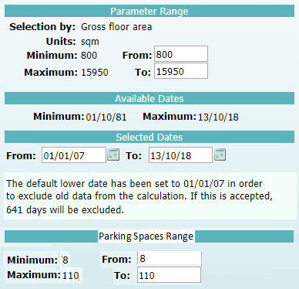
1: ADD PARKING SPACES RANGE TO PRIMARY FILTERING
Filtering by Parking Spaces range available to all land uses where parking spaces are known.
Users can input their desired range or accept the fully inclusive default.
Option available unless trip rates by parking spaces have been selected.
Notes:
So we can now go through each of the approved changes that are currently being worked on by our Systems Developer. Here is the first one. In the next system update, the Primary Filtering stage of the trip rate calculation selection process is to be enhanced by the addition of a “Parking Spaces Range” selection box. This new selection option will be available for all land use sub-categories where the total number of parking spaces at a site are known (including residential land use sub-categories). The new selection will also be included in the recently introduced Filtering Summary screen, and also displayed on TRICS PDF outputs as part of the selection process. Currently there is an option to actually calculate trip rates by parking spaces. However, the new feature will mean that filtering by parking spaces will become a general part of the Primary Filtering process, no matter what trip rate calculation was selected. Say for example a user selected to calculate trip rates by GFA. In such a case a new parking spaces range as shown above will be included as part of the filtering process, defaulted to the highest and lowest available parking space figures in the database). Then it would be up to the user to either just accept the default or input their desired range. Note that if a user wants to actually calculate trip rates by the number of parking spaces, then of course the new selection will not be shown on the screen as this would be duplication – in such cases we will need to leave the Primary Filtering screen as it currently is. It is only when a trip rate calculation parameter other than Parking Spaces is selected that the new selection option will be displayed.

Slide 5
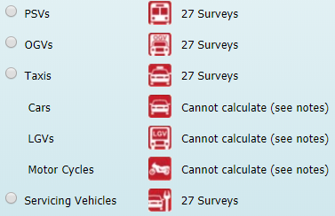
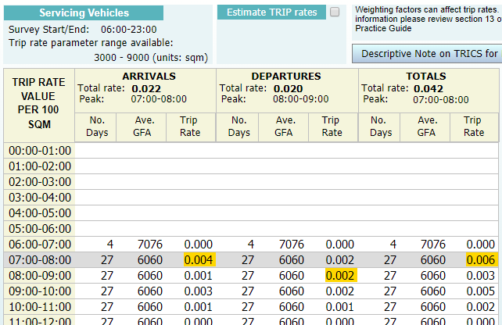
2: TRIP RATES FOR SERVICING VEHICLES
Servicing Vehicles count now included as standard in multi-modal surveys.
Users will be able to calculate trip rates for Service Vehicles.
Calculation option available for individual sites or groups of sites in the usual way.
Notes:
Currently trip rates can be calculated and displayed by each count mode. However, recently we introduced the new Servicing Vehicles count into the system, but as yet no calculations have been available for this. We are now going to introduce trip rate calculations for Servicing Vehicles as an option in the same way as for all other count types. This is being set up so that trip rates by total Servicing Vehicles can be calculated both from within individual sites (like all other count types) or through the standard trip rate calculation filtering process (with the Servicing Vehicles being shown as a calculation option for all multi-modal calculations). We are updating all screens and PDF outputs so that trip rates for Servicing Vehicles can be selected by users as a standard mode. The standard rules of survey inclusion will apply. As you can see in the example given here, we have the standard style of trip rate calculation results table shown, only this time you can see that it is Servicing Vehicles that has been selected as the “vehicle type”. The process of calculation is exactly the same as for any other vehicle type option available.

Slide 6
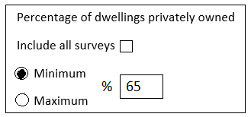
3: ADD PRIVATELY OWNED DWELLINGS SELECTION IN PRIMARY FILTERING
Available for all residential land use sub-categories where number of dwellings present.
“Include all surveys” option set as default.
Users able to input a minimum or maximum percentage of private dwellings into Primary Filtering search criteria.
Notes:
Within the Primary Filtering stage of the trip rate calculation selection process for Residential land use categories we are introducing a selection option whereby users can include sites by the proportion of occupied dwellings that are privately owned. This selection option is being made available whichever Residential trip rate calculation parameter option has been selected. The selection box will have the heading “Percentage of dwellings privately owned” (as you can see in the example shown), and underneath this there will be be two radio buttons plus a percentage field. The two radio buttons are named “Minimum” and “Maximum”, and the user will be able to either select one or accept the default option of including all surveys (this will be set as default by showing a small tick box which the user will need to uncheck in order to access the radio buttons). So, using this new selection option, the user will be able to choose to include only sites that have a minimum or maximum percentage of the total number of occupied dwellings as privately owned. There will be some sites that do not have the privately owned/non-privately owned split available. In such cases, whenever a user unchecks the “Include all surveys box”, such sites will automatically be excluded from the selected sample. In the example above, only sites that have at least 65% of dwellings as privately owned are to be included in the selected set.
This new option will be available for all Residential sub-categories where the number of privately owned and non-privately owned dwelling fields are present in the Development Details section (so for example this will not apply to the Holiday Accommodation sub-category).

Slide 7
4: ADD “NUMBER OF SEATS” DATA FIELD TO SOME 06 LAND USE SUB-CATEGORIES
Simple data field to be added to the following sub-categories:
06C (Pub/Restaurant)
06/D (Fast Food – Drive Through)
06/H (Pub/Restaurant + Hotel)
06/I (Public House – without restaurant)
Note this is just a data field and not a trip rate calculation parameter option.
Notes:
A new data field called “Number of seats” is going to be added to the Development Details screen for the following 06 land use sub-categories:
06/C (Pub/Restaurant)
06/D (Fast Food – Drive Through)
06/H (Pub/Restaurant + Hotel)
06/I (Public House – Without Restaurant)
This will simply be the addition of a new data field for new surveys entering the database (it will be greyed out for all surveys within the database at the time of the December 2018 release of TRICS version 7.5.4), and all data collected in the 2019 programme will include the new field. Note that this is just a new data field being added to provide users with detail about the total amount of seating space at these sites, and it is not being added as an additional trip rate calculation parameter option.

Slide 8
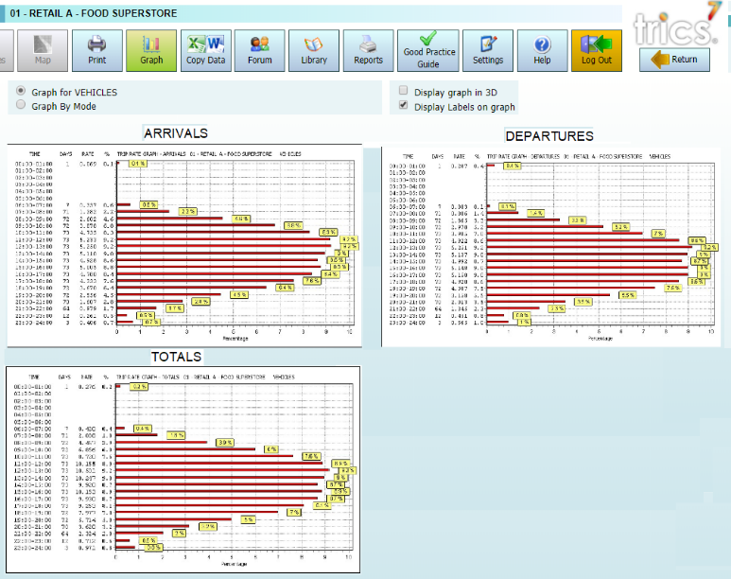
5: DISPLAY ARR/DEP/TOT GRAPHS ON THE SAME SCREEN
Currently users have to select the direction to display a trip rate graph.
Users will now be able to display all three graphs on one screen.
Notes:
In the current version of TRICS, users are required to select the direction of flow before displaying a trip rate graph (with the options being Arrivals, Departures or Totals). In the next system update we are changing things so that all three graphs are displayed at the same time, rather than asking users to make a choice. I had produced a mock-up of what this could look like, which is what you are seeing here, but it is more likely that the graphs will be displayed vertically with the introduction of a scroll bar. This change just makes the process more efficient and more convenient for our users.

Slide 9
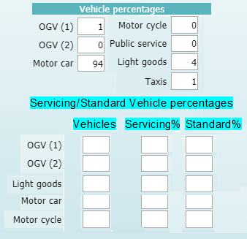
6: AUTOMATED % SPLIT BETWEEN STANDARD VEHICLES & SERVICING VEHICLES BY TYPE
Currently the total vehicle percentages split is displayed.
A new table will show the total vehicles by type, followed by the percentage which are servicing vehicles and the percentage which are standard vehicles.
All data to allow this is already in the system.
Notes:
Here is the next change being made. We are going to provide users with percentage splits between standard vehicles and servicing vehicles, by servicing vehicle type. Currently within the servicing vehicles count we have cars, LGV’s, OGV1’s and OGV2’s. As we have the same breakdown for the standard vehicles counts, this allows us to provide a percentages breakdown between standard vehicles and servicing vehicles. This will be displayed as a table underneath the existing “Vehicle percentages” percentage split (that may be changed to show two columns to save vertical space. I have produced a mock-up of the new table which you can see here. In this example the figures are blank, but the new “Vehicles” column will be the total (inbound + outbound) vehicles for each type, taken from their respective counts. Note that for OGV(1) and OGV(2) we just have a total count for all OGV’s with a percentage split given, but the original datasheet does contain an OGV(1) and OGV(2) breakdown, so this will be used to split the total. For all other vehicle types we will just take the total two-way count and put it in the Vehicles box. Note I have included Motorcycles here, as in another amendment we are adding these to the Servicing Vehicles count. For all existing surveys this will be greyed out, with it only being included for surveys undertaken in 2019 onwards. To get the percentage figures for the Servicing and Standard vehicles we will just need to take the Standard counts and work out the percentage of these that are Servicing Vehicles, then take the remaining percentage as Standard. For example, if there were 10 LGV’s in the Standard LGV count, and 4 in the Servicing count, the figures would show as 60% Standard and 40% Servicing, and so on.

Slide 10
7: ADD MOTORCYCLES TO SERVICING VEHICLES COUNTS
Servicing Vehicles count currently consists of cars, LGV’s and OGV’s.
Motorcycles category being added for all counts taking place from 2019 onwards.
Notes:
Following on from the previous slide, we will also be adding motorcycles as a new column in the Servicing Vehicles count, for all surveys undertaken in 2019 onwards. Currently, the Servicing Vehicles count is split between cars, LGV’s and OGV’s. For existing surveys in the database the new motorcycles column will not be present (or if it has to be it will be greyed out, with this new category only being included for surveys being undertaken from 2019 onwards).

Slide 11
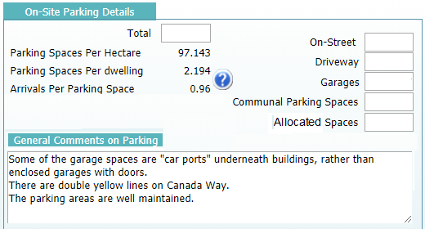
8: NEW “ALLOCATED SPACES” PARKING SPACE TYPE FOR RESIDENTIAL SURVEYS
Up until now, specifically allocated parking spaces at residential sites have been included as “communal” spaces.
All surveys from 2019 onwards will now include a specific “allocated spaces” parking space category.
Notes:
A new type of parking space for Residential surveys is being introduced, as this type of space is being found at an increasing number of sites. We are introducing the new “Allocated Spaces” category, and a mock-up of the inclusion of this new type is shown here. Up until now, specifically allocated parking spaces have been included within the “communal” category, but it has been pointed out that this is probably not appropriate, hence the introduction of the new category. For all existing surveys in the database this new category will be greyed out, with it only being made available for surveys undertaken from the start of 2019 onwards.

Slide 12
NEW LAND USE SUB-CATEGORIES (IN 2019)
Three new land use sub-categories are to be added in 2019 (once survey data has been collected).
06/J (Drive Through Coffee Shop)
03/P (Assisted Living)
07/X (Trampoline Park)
Notes:
We will also be introducing three new land use sub-categories in 2019, as you can see here. The first of these is 06/J (Drive Through Coffee Shops). This sub-category has been something that users have been asking about for a few years now, and we have been making attempts to get some surveys agreed for this new type of development. Hopefully in 2019 we will be able to include some in our annual data collection programme, and as soon as we do have some data the new sub-category will be introduced into the database and the data added. We are also introducing the 03/P (Assisted Living) and 07/X (Trampoline Park) sub-categories, as these are also two popular requests taken from our TRICS User Survey feedback. Again, as soon as data is secured for these new sub-categories they will be introduced into the database, but we are committed to obtaining data for all three of these development types.

Slide 13
TRICS Version 7.5.4 – December 2018
Release date of Thursday 20th December 2018.
All users will be notified by email through Mailchimp.
Update will contain all developments outlined today (excluding new land use sub-categories which will be added when data arrives).
Significant amount of new survey data also being included in the update.
Watch out for the 2019 TRICS User Survey for another chance to have your say on the development of the system.
Notes:
To close my presentation I can tell you a bit about the forthcoming TRICS 7.5.4 release. It will be made live on Thursday 20th December, and all users will as usual be notified about its availability via the Mailchimp service (which we use for all direct TRICS email correspondence). The system update will include all of the changes outlined today in this presentation, excluding the new land use sub-categories that will come on-line as soon as we have the first surveys completed and ready to go onto the database. Also, we will be adding a significant amount of new survey data to the update, as the team have been working on data input and validation over the last few months, as we do throughout the year. And finally, keep an eye out in 2019 for the next TRICS User Survey, and make sure that you have your next chance to have a direct say in the future of TRICS development. As you can see here, these changes to the system we are making have come from you the users, so your views are always greatly valued by us here at TRICS and really do make a difference.

